Slide 1




Mortality risk
COVID-19 mortality prediction using
ensemble learning and grey wolf optimization
To m a s z J a n e c z k o , L u k á š H of m a n
1

Slide 2





About article
This article, titled "COVID-19 mortality prediction using ensemble learning and grey wolf optimization", was published in PeerJ Computer Science on February 24, 2023, by a group of Chinese researchers.
It proposes a computational method to predict the mortality risk of COVID-19 patients. The method achieves an AUCROC value of 0.7802, and requires only 10 features, reducing diagnostic cost and potentially improving prognostic time.

Slide 3
Introduction
The COVID-19 pandemic had a profound and far-reaching impact on the global population, with over 600 [766] million confirmed cases and over 6.5 [7] million deaths worldwide. This unprecedented health crisis led to widespread lockdowns, social distancing measures, and economic disruptions, significantly altering daily life and societal norms.
[In this study, we propose an effective computational model to identify the mortality risk of COVID-19-infected patients using ensemble learning in combination with a genetic algorithm (Katoch, Chauhan & Kumar, 2021).] - 3rd page 2nd paragraph

Slide 4
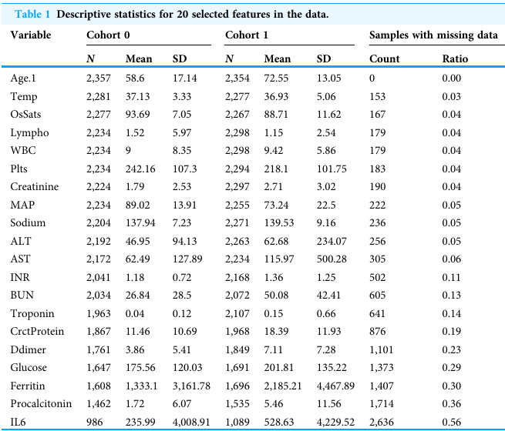
Our dataset
We use the provided dataset, which can be found in https://www.nature.com/articles/s41598-020-73962-9
Number of cases: 4711 (between 1st March to 16th April 2020)
Number of variables: 85 (most secondary)
20 original variables (features) were obtained for
model development
Samples having “Derivation cohort = 1” were used as training
samples, while samples having “Derivation cohort = 0” were used as validation (25%) samples and test samples (75%)
5

Slide 5
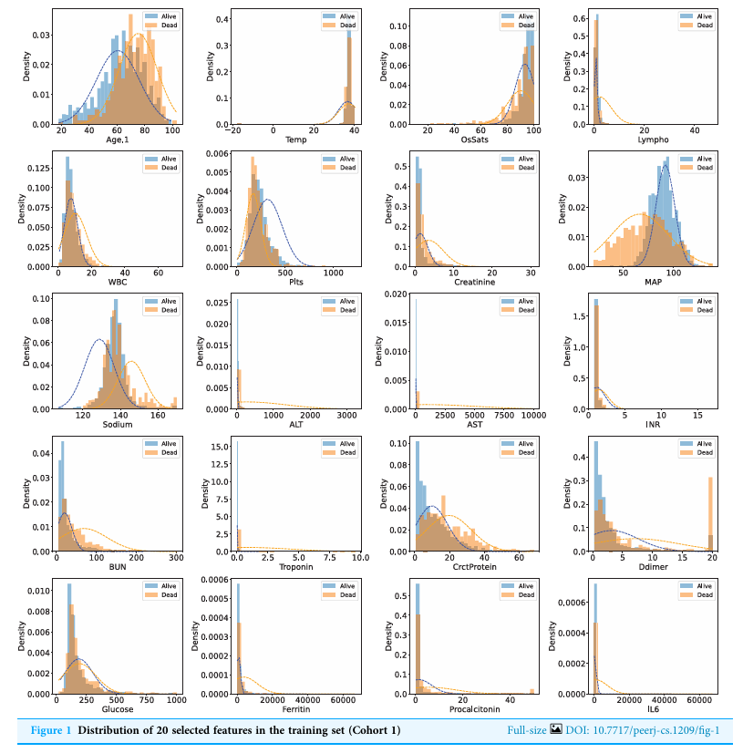
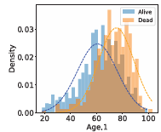
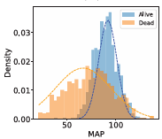
Distribution of features

Slide 6
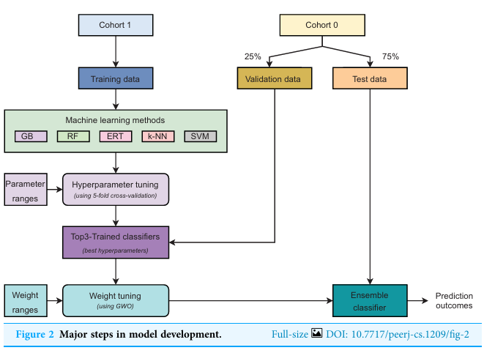
Model development
5 different learning algorithms:
- gradient boosting (GB)
random forest (RF)
extremely randomized trees (ERT)
k-nearest neighbors (k-NN)
support vector machines (SVM)
Our proposed strategy is weighted ensemble learning which means each base model is allocated a weight values (w1, w2, and w3) explored by using the grey wolf optimization (GWO) algorithm.
Three best-performing models were selected as the base classifiers for the ensemble learning strategy. The top three classifiers were then retrained on the whole training set using their optimal hyper-parameters.
The ensemble model predicts a probability for each sample:

Slide 7
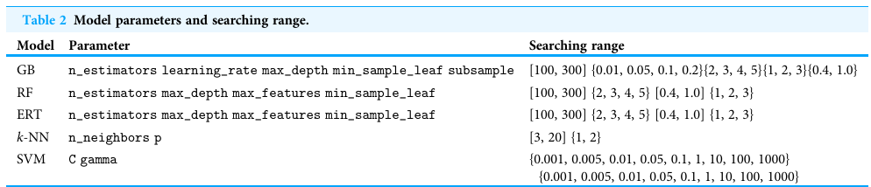
Set of important parameters for each model
It was done to fine-tune the:
GB, RF, ERT, k-NN, and SVM-based classifiers

Slide 8
GWO technique
was inspired by the cooperative hunting behavior of grey wolves
meta-heuristic optimization algorithm
accomplishes more satisfactory job than other algorithms at discovering the most promising strategy for nonlinear double-layer grids
three wolves: Alpha (a), Beta (b), and Delta (d) representing the best
solution, the second-best and third-best solutions
is characterized by three stages:
(i) Encircling
(ii) Hunting
(iii) Attacking
- is a complicated mathematical model

Slide 9
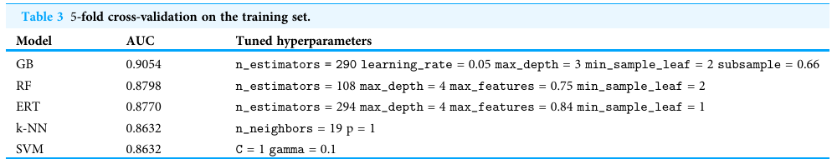
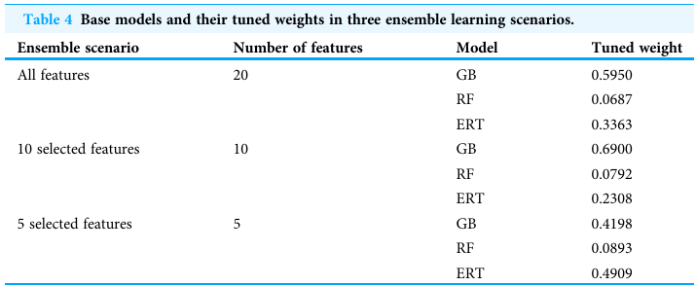
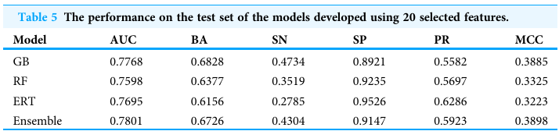
Results

Slide 10
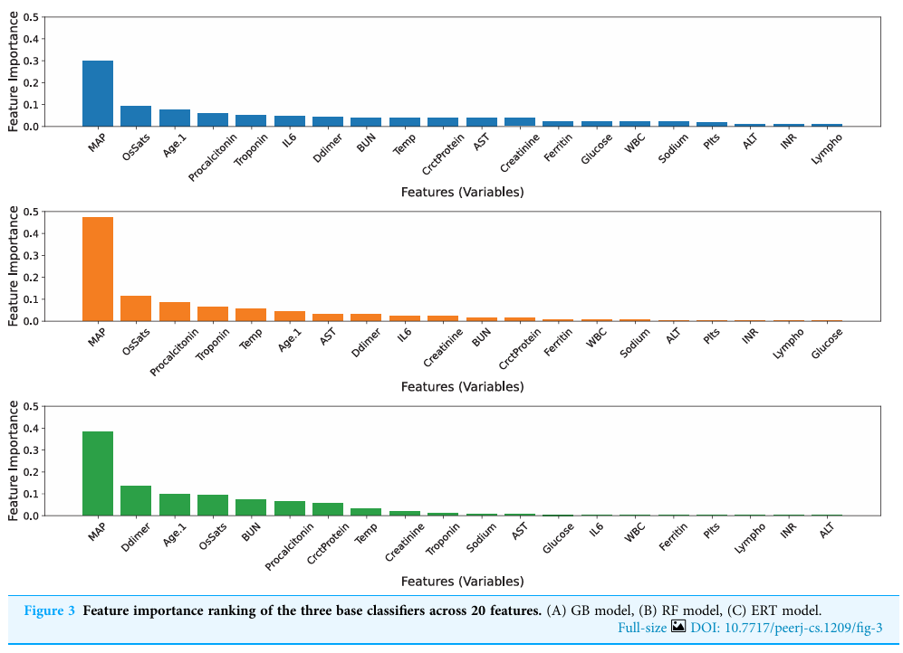
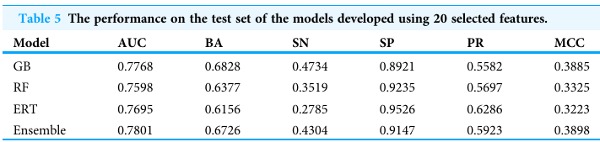
Results for model with 20 features

Slide 11
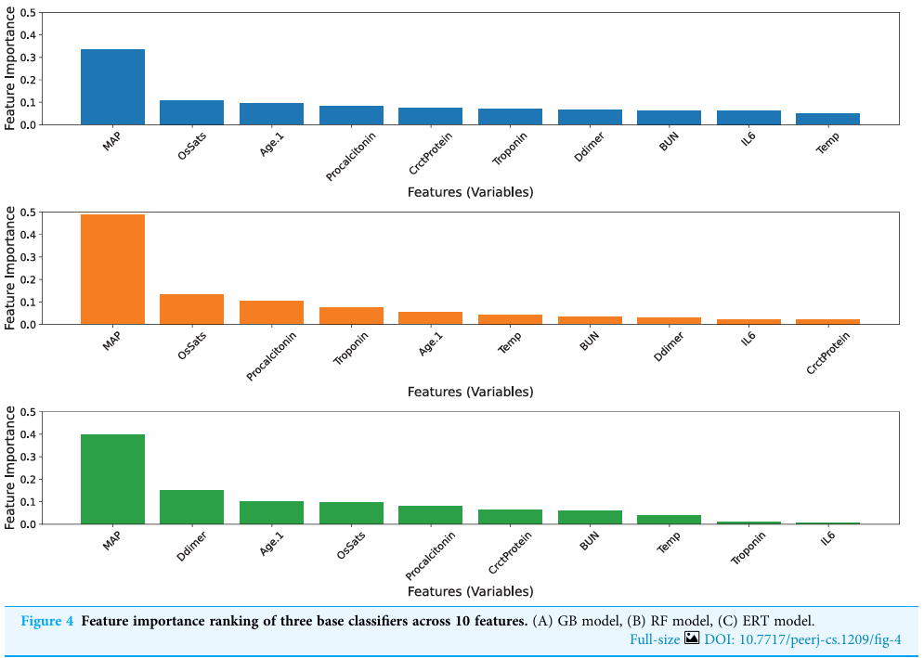
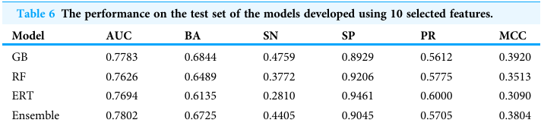
Results for model with 10 features

Slide 12
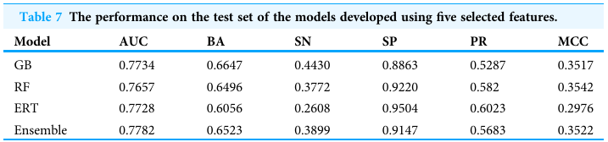
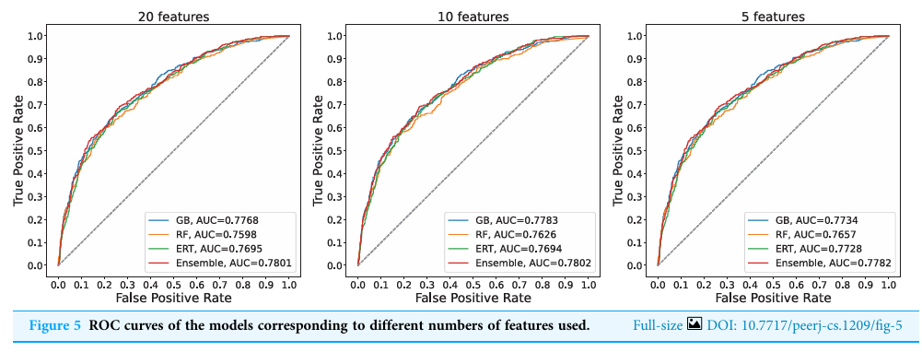
Results for model with 5 features + ROC curves

Slide 13


Conclusions
Optimal approach:
Model developed with 10 features (the top five features of each base model) is the optimal approach
Importance of data features:
The reduction of medical information used in predicting mortality risk can improve prognostics as well as save a large budget on laboratory testing
GOW:
The grey wolf optimization is a fast, robust, and effective optimization technique to explore the suitable contributing weights for each base model to promote the prediction power in the ensemble learning strategy.
In the future ->:
The inability of finding globally optimized weight and the non-controlling of stochastic-based process need to be addressed.

Slide 14
Our realization - requirement
﻿Python 3.11
matplotlib==3.9.2
numpy==2.1.2
pandas==2.2.3
scikit-learn==1.5.2
scipy==1.14.1
seaborn==0.13.2

Slide 15

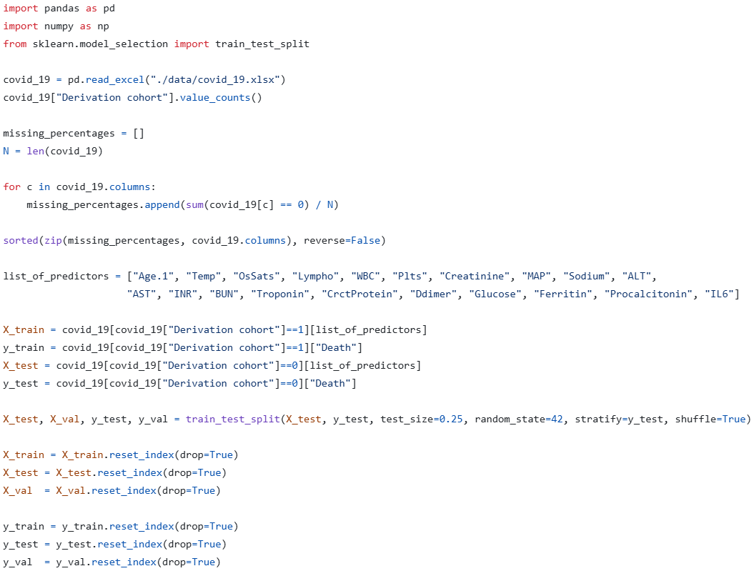


Data processing

Slide 16
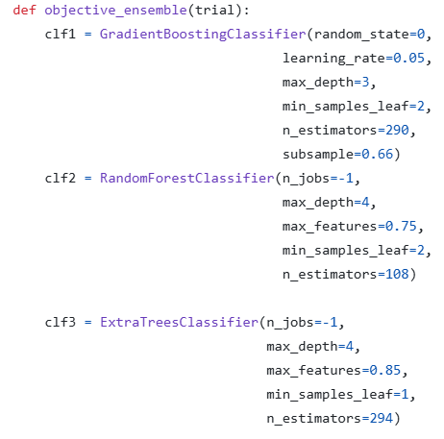
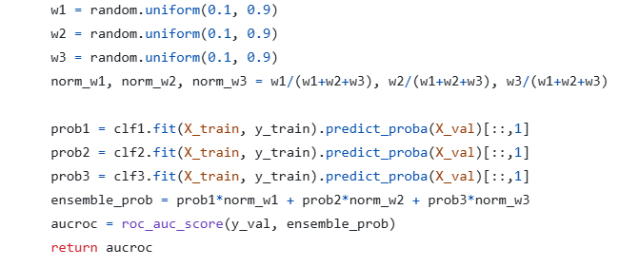
Optimization

Slide 17
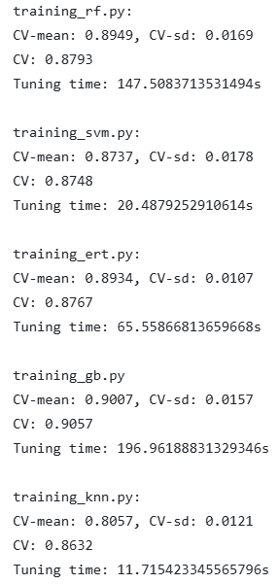



Other files

Slide 18
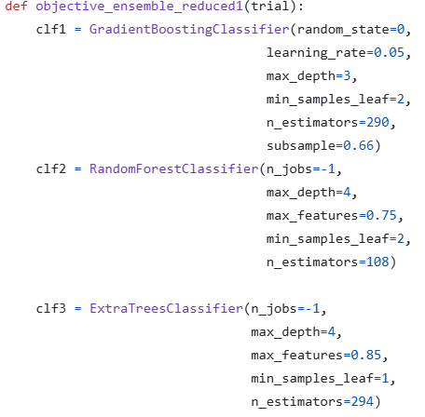
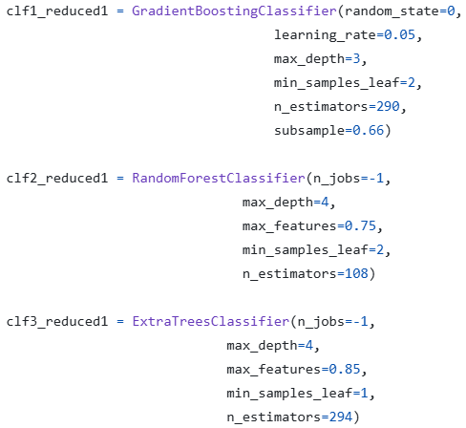
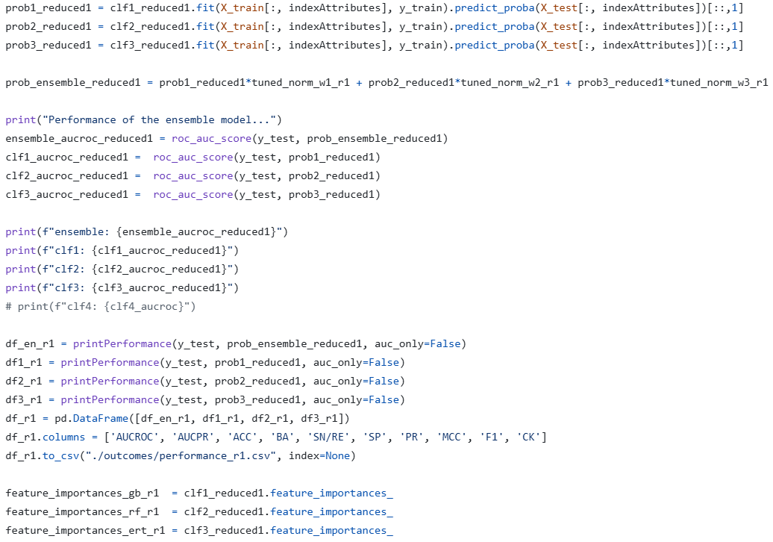
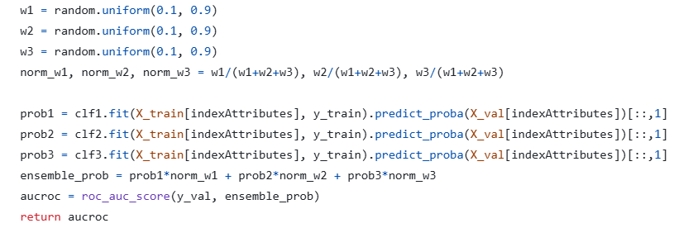
Three Ensembles

Slide 19
Three Ensembles – part 2

Slide 20
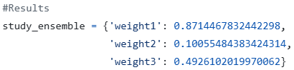
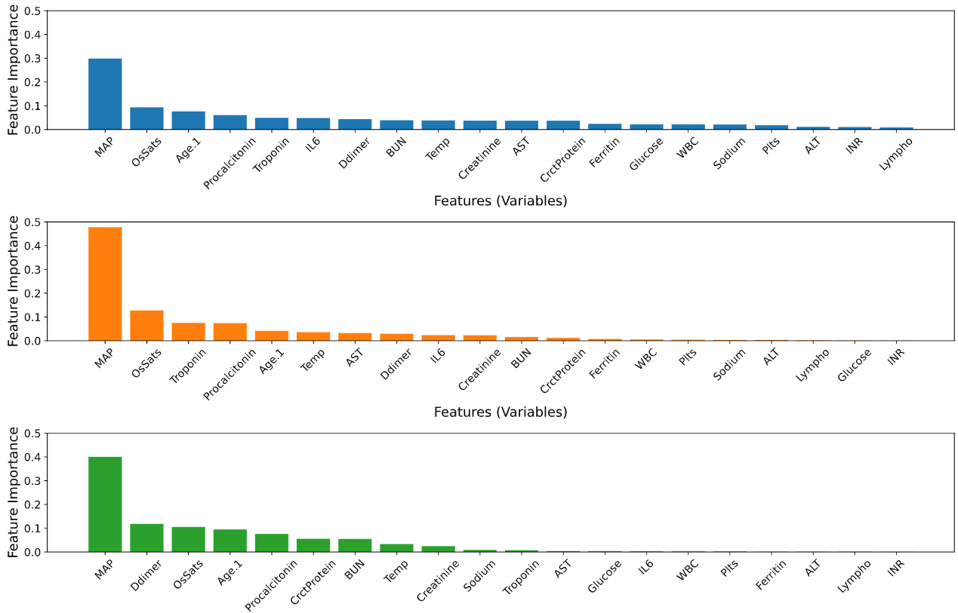
Results for First Ensemble

Slide 21
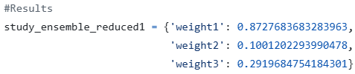
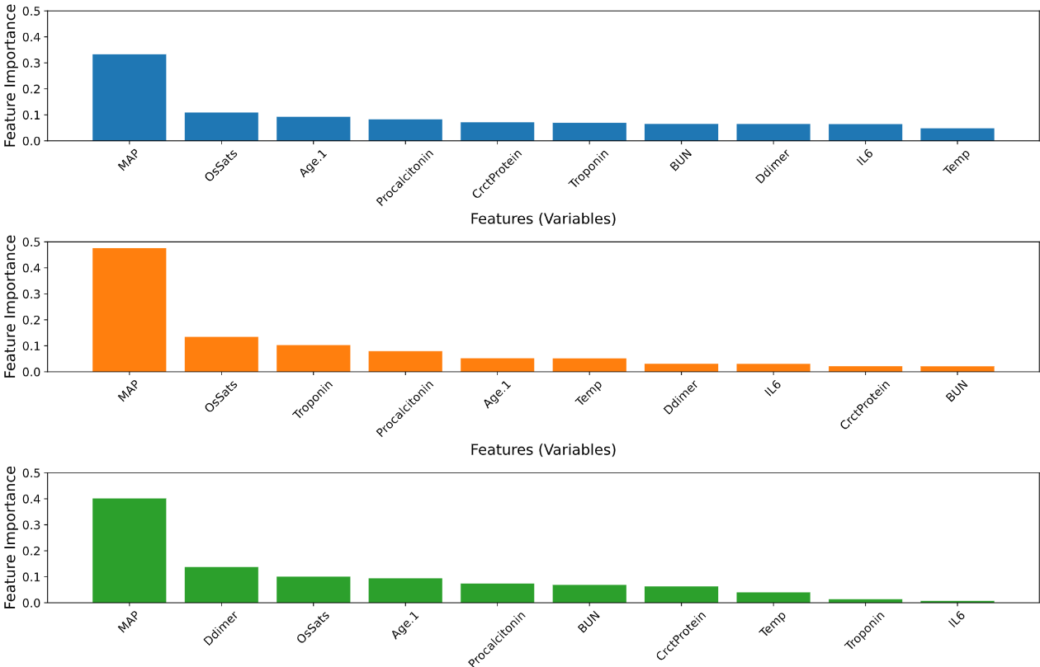
Results for Second Ensemble

Slide 22
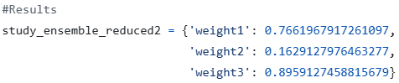
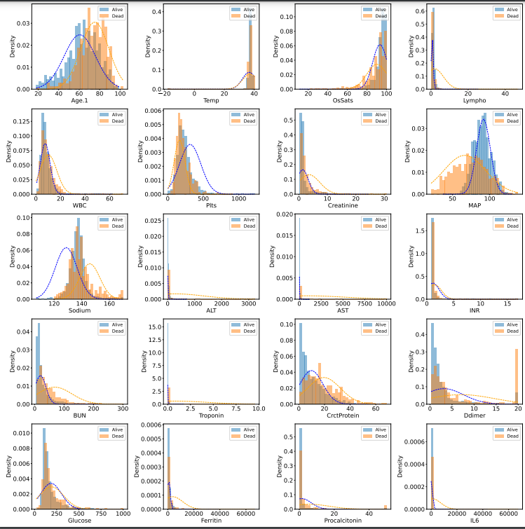
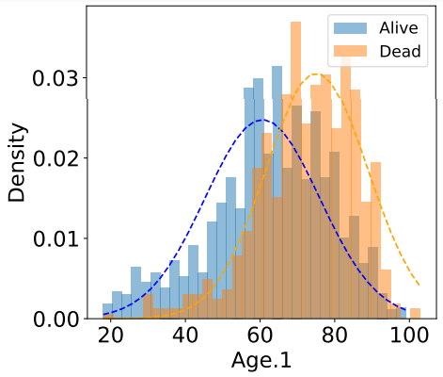
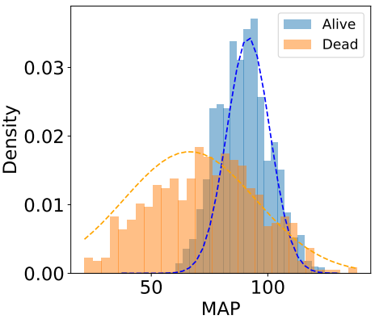
Results for Third Ensemble + Distribution of features

Slide 23
Our Conclusions
Similar result plots:
We have received very similar plots with argumental difference, which is a very satisfying for us result.
High computing power:
Due to a big numbers of variables, we had to skip some of the computations and instead we used the partial result, which were written in the Article.
Complexity of the problem:
Problem is very complex on different areas e.g., there are 5 different model trainings.

Slide 24

Used sources
https://peerj.com/articles/cs-1209/
https://pmc.ncbi.nlm.nih.gov/articles/PMC10280255/
https://pmc.ncbi.nlm.nih.gov/articles/PMC10280255/
https://zenodo.org/records/7472400
https://figshare.com/articles/dataset/covid_19_xlsx/21739745/1?file=38570948
https://peerj.com/articles/cs-1209/
https://en.wmu.edu.cn/__local/E/97/48/FB8AA293B2E6759FE28276BD1A8_A02D833D_71A05.jpg

Slide 25


Thank you for your attention
Co-authors:
Tomasz Janeczko, Lukáš Hofman
https://github.com/LuhiHofi/Aprendizaje
-Computacional
Lab 3 Task
Aprendizaje Computacional (2024-25) Universidad de Málaga
20

